Slide 1

Progressive 1
Units 1 - 3

Slide 2
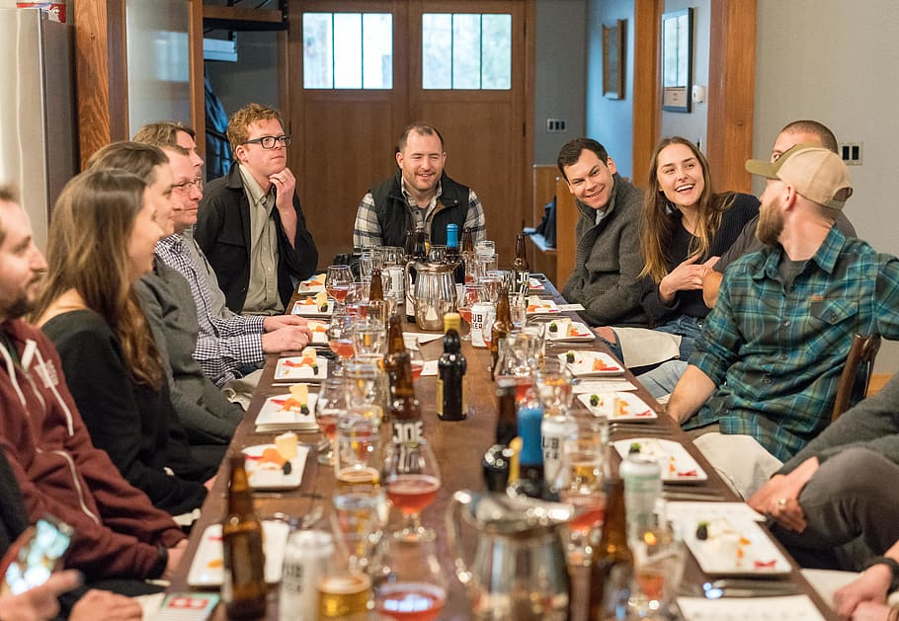
Unit 1
Who we are

Slide 3
Question words
There are different type of questions words, each of them look for some specific information. They always go before the auxiliary or verb “be”.
Question word | When to use | Special notes
What | Ask for specific information | You can use a specific object after question word to reduce context E.g. What color / What car.
Which | Ask for something specific in a contextual group | You can use a specific object after question word to reduce context E.g. Which movie/ Which car.
When | Ask for a specific time
Where | Ask for a specific location
Who | Ask for a person | Ask for a person who does action or complements action
Whose | Ask for a possessor | Ask for a person or object who is the owner of an object.
Why | Ask for a reason | Ask with “Why”, answer with ”Because”
How | Ask for the way/form things are done | This question word can be modified in context depending on next word (How much, how old) in this case indicates a quantity.

Slide 4
Indirect questions
Indirect questions are common in the English language, to create them, we need to use one of the following expressions:
Can you tell me …?
Do you know …?
I’d like to know …. .
Do you have any idea…?
I wanted to find out … .
I wonder…. .
Depending on the type of question (Open or Closed), we use if or the Question word. Don’t forget that we take the original question and transform it to an affirmative statement.
Closed question – If
Open question – Question Word
Do you study at UNID?
You study at UNID.
Can you tell me if you study at UNID?
Where were you born?
Where you were born.
Can you tell me where you were born?

Slide 5
Indirect questions
Be: Change position of “be” and subject.
Are you happy? > You are happy.
Where were you yesterday? > Where you were yesterday.
X
Remember!!!
Closed questions are always answered with yes or no.
Open questions are answered with specific information.
To create them, we must follow the following 4 steps:
X
Identify the type of question:
Closed: Are you happy? / Do you like sushi?
Open: Where do you live? / Why are you here?
Select a phrase to use, remember they always go at the beginning.
?
Closed question:
Can you play soccer? > You can play soccer. > Can you tell me if you can play soccer?
Closed question:
Where are you from? > Where you are from. > I wonder where you are from.
X
I’d like to know …. .
I wanted to find out … .
I wonder…. .
Can you tell me …?
Do you know …?
Do you have any idea…?
Do / Does / Did: Eliminate the auxiliary.
Do you play soccer? > You play soccer.
What does she eat? > What she eats.
Remember to conjugate verb when transforming.
X
Transform the question into an affirmative sentences:
Finally!!! Join them.
Closed question – If
Open question – Question Word
Be
Do/Does/Did
Other
Other auxiliaries: Change position of the auxiliary and subject.
Can you play soccer? > You can play soccer.
What has she eaten? > What she has eaten.
Remember to conjugate verb when transforming.
X
!

Slide 6

Unit 2
So much stuff

Slide 7
Present Perfect with ever and never
We normally use the present perfect to talk about experiences we have had in our lives.
I have been to Cancun many times.
I have eaten Japanese food before.
In present perfect, we use ever in questions to know if a person has had and experience before:
Have you ever seen “Rocky IV”?
Have you ever traveled to another country?
And we use never exclusively in affirmative to indicate that we haven’t had an experience.
I have never been to Spain. (I haven’t gone to Spain)
I have never eaten Japanese food before. (I haven’t eaten Japanese food)

Slide 8
Present Perfect with for and since
For and since are used to indicate the duration of the action that started in past and continues now. They indicate the same idea in two different ways:
Since is used to indicate when the action started.
I have lived in Aguascalientes since 2014. (I started to live in Aguascalientes in 2014, and I continue living here)
For is used to indicate the specific period of time.
I have lived in Aguascalientes for 11 years. (I have 11 years living in Aguascalientes)

Slide 9
Present Perfect with already and yet
Already is used to emphasize that an action has been completed, usually before it was expected. We use it in affirmative sentences.
I have already done my homework. (I emphasize that the homework is finished)
We can use yet in both negative and questions with a small difference.
In negative, we use it to indicate the action is not completed yet, but we expect it to be ready in a moment.
I haven’t talked to my father yet. (The action is not completed but it will be eventually).
In question, we use it to know if the person has completed the action.
Have you paid the rent yet? (I don’t know if you paid the rent).

Slide 10
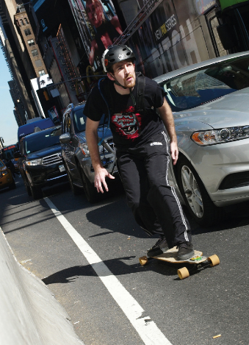
Unit 3
Smart moves

Slide 11
The use of articles.
In English, we have a total of three articles (a, an and the), they are used depending on one of the next situations:
A / An
Talk about countable singular objects.
Talk about an object the first time (Establish a context).
The
Talk about something specific.
Talk about unique things.
No article
Talk about general things.
Talk about proper names.
Talk about an object mentioned with a /an before hand.
Plurals.

Slide 12
Modals for advice.
We can use some modals to give advice to people. Every time we use modals, the verbs are used in simple form. The modals we can use are:
Should / Shouldn’t
In affirmative, we use to indicate something that is a good idea.
Could (Only affirmative and questions)
We use it to indicate possibilities.
In negative, we indicate something is not a good idea.
You should visit Exedra.
You shouldn’t go to Lomas del Ajedrez at night.
Should I eat at “Las Espadas”?
Yes, you should. / No, you shouldn’t.
You could visit The Broken Christ in San José.
Could I travel by bus to Calvillo?
Yes, you could. / No, You couldn’t

Slide 13
Modals for advice.
We can use some modals to give advice to people. Every time we use modals, the verbs are used in simple form. The modals we can use are:
Would
We use would directly to give an advice.
I would visit Exedra.
I wouldn’t go to Lomas del Ajedrez at night.
Would you eat at “Las Espadas”?
Yes, I would. / No, I wouldn’t.

